Slide 1
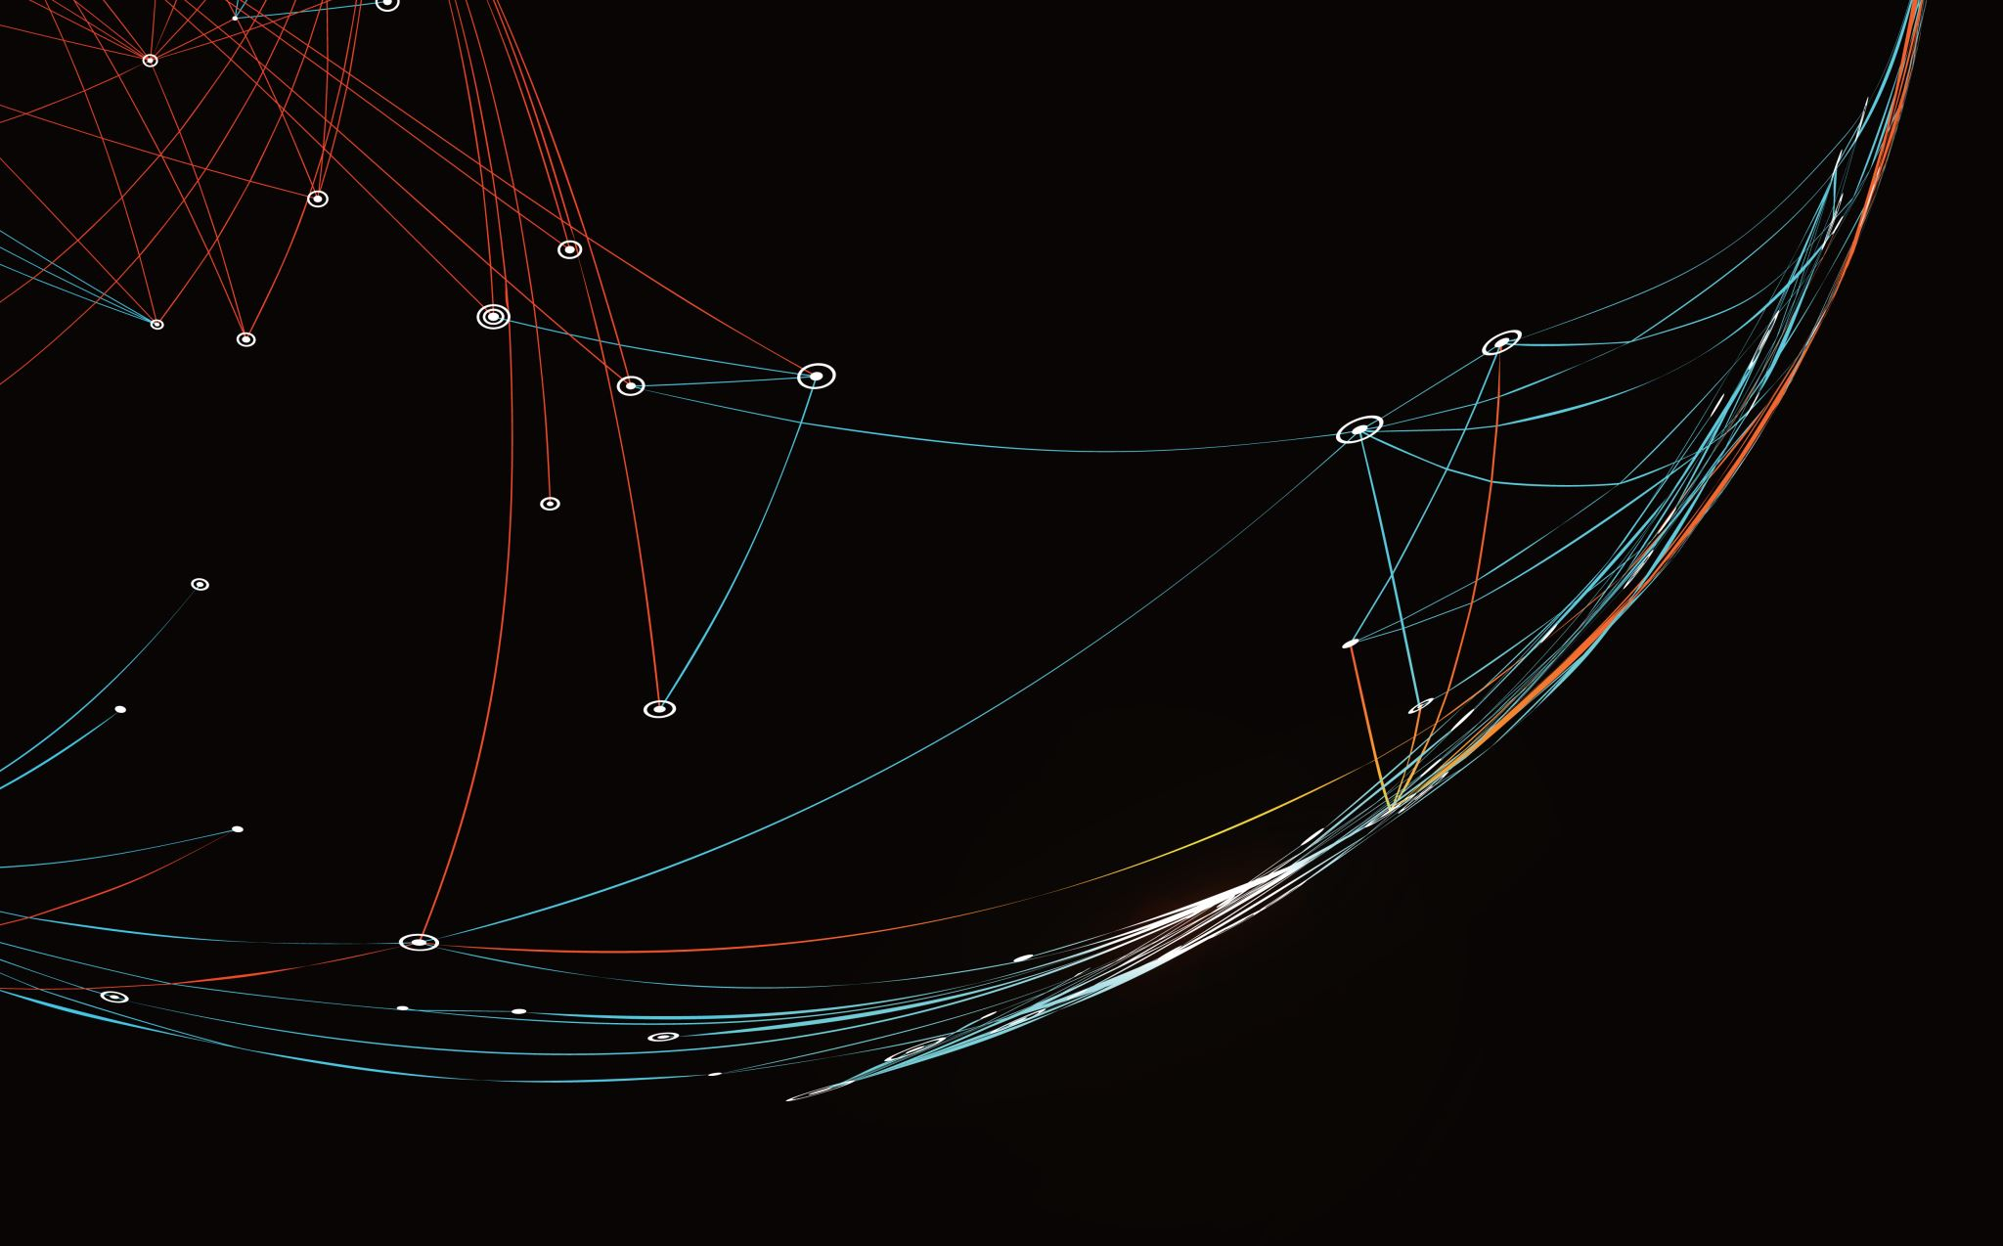
Security Assessment and Risk Management
Week 14 – Information Criticality Matrix

Slide 2
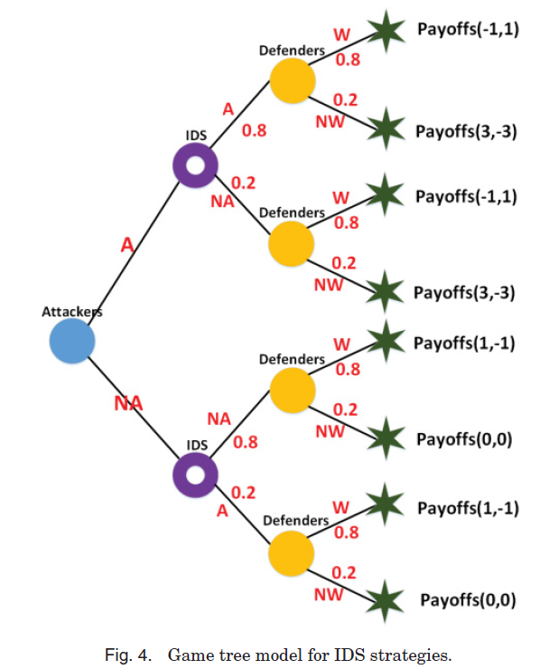
Game Tree for IDS
SA = {NA, A} represents attackers’ strategies, wherein NA represents not attack and A represents attack.
SI = {NW,W} represents defenders’ strategies, wherein NW represents not alert and W represents alert.
For example, we assume the IDS’s detection results mixed probability matrix:
P = (0.8, 0.2) _ (0.2, 0.8)
Notes:
SA = {NA, A} represents attackers’ strategies,
wherein NA represents not attack and A represents attack.
SI = {NW,W} represents defenders’ strategies,
wherein NW represents not alert and W represents alert.
For example, we assume the IDS’s detection results mixed probability matrix:
P =
0.8 0.2
0.2 0.8
A game tree is a graphical representation of a sequential game. It provides information about the players, payoffs, strategies, and order of moves. The game tree consists of nodes (or vertices), which are points at which players can take actions, connected by edges, which represent the actions that may be taken at that node.

Slide 3
Strategies
Dominant Strategy: I’m doing the best I can no matter what you are doing.
Nash Strategy: I’m doing the best I can given what you are doing.
Bayesian Nash Strategy: I’m doing the best I can in expected value terms, accounting for the uncertainties that affect what you do and that affect outcomes.
Rationalizable Strategy: I’m doing the best I can given my expectations regarding your likely behavior, what I think are your beliefs about me and my likely behavior, and whether your beliefs and likely behavior are themselves rationalizable

Slide 4
Attrition
Attrition is a position of maintaining a strategy for a period of time to slowly wear down an opponent.
Wars of attrition often arise in business (and in other settings as well). The game arises when two (or more) firms compete with each other, each one losing money but hoping that the competitor will eventually give up and exit the industry.
In cybersecurity, attrition is a strategy that often acts as a vehicle for change…

Slide 5
Cybersecurity Attrition
Scenario:
You come to an organization and they have a problem – collisions in the naming convention.
Currently all users go by their last name (i.e. johnson).
Legacy systems require no more than six characters (i.e. johnso).
If a user with that name already exists, an ordinal number is designated (i.e. johns1, johns2… john11, etc.)
This exacerbates problems because users with similar names snowball (Chad Johnson and Robert Johns collide, causing johns1 and johns2…)

Slide 6
Options
Cut-Over – Pick a date, issue new credentials to everyone and migrate.
Disruptive
Potential counter-productive
Attrition – Pick a date, begin issuing credentials with the new naming convention, run both systems until the old names are cleared out.
Mixed – Pick two dates. Start with attrition. Second date is a cut-over date.

Slide 7
Cooperation
Cooperative vs. Non-cooperative
In cooperative games, players can plan together or make binding agreements before playing the game. In contrast, in non-cooperative games, each player determines his own strategy; there is no binding or agreement.
Inter-organization cooperation requires symmetric knowledge. Leadership only requires asymmetric knowledge.
True security does not rely on obfuscation, but knowledge is power. Careful consideration should be given to the level of transparency required.

Slide 8
Symmetric vs Asymmetric Knowledge
Perfect vs. Imperfect Information
In an imperfect information game, the players do not know when an opponent makes a move. In contrast, in a perfect information game, the players know all the actions taken by the other players.
Complete vs. Incomplete Information
In an incomplete information game, the payers do not know opponents strategies or payoffs. In contarst, in a complete information game, the players know the strategies, preferences, and payoffs of the other players.

Slide 9
Adversarial Knowledge
An information criticality matrix is a way of measuring the reaction of security processes.
If you are 99% successful in closing down attackers, you are 0% successful in keeping them out. Information criticality matrixes help close the gaps in your environment.

Slide 10
ICMs
In cybersecurity we talk about
Basic principles
Kill-chain analysis
Best practices
These are derived from ICMs – idiographic information to form nomothetic templates.
Findings form individual incidents
Intel from sources
Information about attackers
Information about your ability to detect attackers.

Slide 11
The Perfect Storm
Explosive growth and aggressive use of information technology.
Proliferation of information systems and networks with virtually unlimited connectivity.
Increasing sophistication of threat including exponential growth rate in malware (malicious code).

Slide 12
The Threat Situation
Continuing serious cyber attacks on public and private
sector information systems targeting key operations,
assets, and individuals…
Attacks are organized, disciplined, aggressive, and well resourced; many are extremely sophisticated.
Adversaries are nation states, terrorist groups, criminals, hackers, and individuals or groups with hostile intentions.
Effective deployment of malware causing significant exfiltration of sensitive information (e.g., intellectual property).
Potential for disruption of critical systems and services.

Slide 13
Advanced Persistent Threat
An adversary that —
Possesses significant levels of expertise / resources.
Creates opportunities to achieve its objectives by using multiple attack vectors (e.g., cyber, physical, deception).
Establishes footholds within IT infrastructure of targeted organizations—
To exfiltrate information.
Undermine / impede critical aspects of a mission, program, or organization.
Position itself to carry out these objectives in the future.

Slide 14

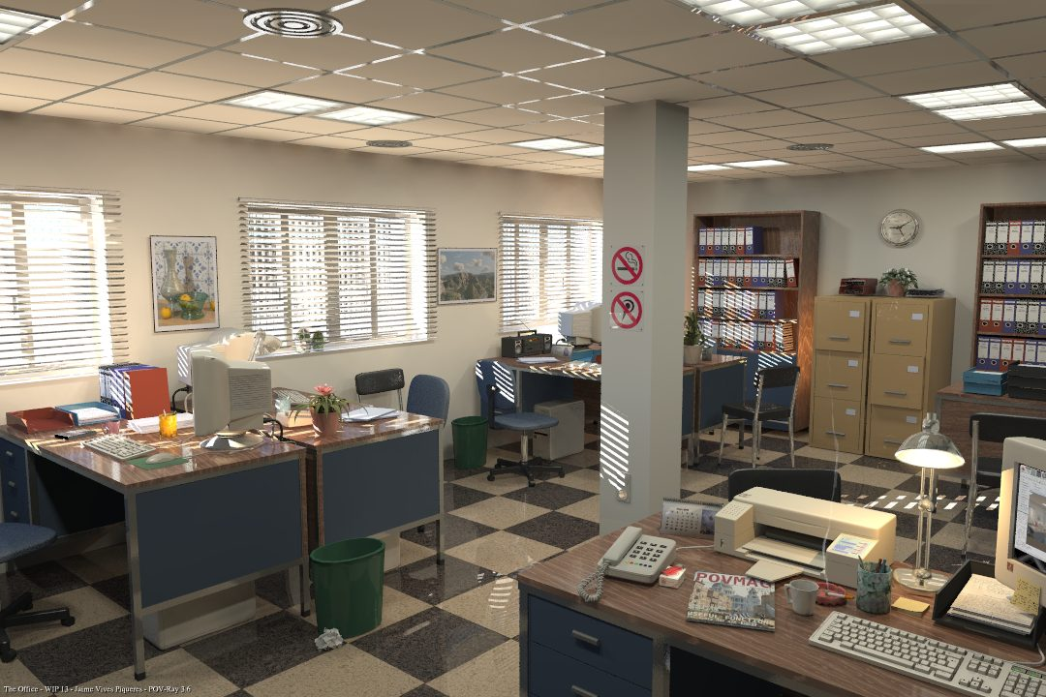
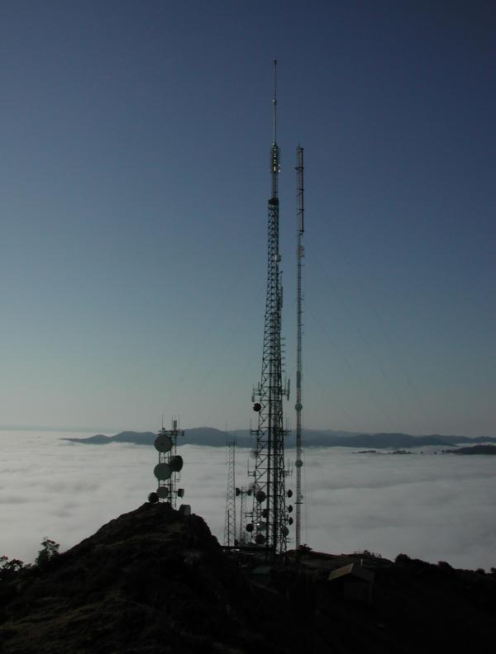
Unconventional Threats to Security
Connectivity
Complexity
Culture

Slide 15
Active Cyber Defenses – The Future
Develop risk-aware mission and business processes.
Develop and implement enterprise architectures with embedded information security architectures that support organizational mission/business processes.
Use information technology wisely considering current threat landscape (capabilities, intent, and targeting).
Develop and implement robust continuous monitoring programs.

Slide 16
Cyber Defense Vision Core Principles
Strong, resilient, penetration-resistant information systems supporting core missions / mission processes.
Ongoing monitoring of the security state of information systems and environments of operation.
Continuous improvement in security controls.
Flexibility and agility in cyber security and risk management activities.

Slide 17
Core Concepts IT Products and Systems
Modularity.
Layering.
Monitoring.
To achieve defense-in-depth and defense-in-breadth.

Slide 18
Dual Protection Strategies
Boundary Protection
Primary Consideration: Penetration Resistance
Adversary Location: Outside the Defensive Perimeter
Objective: Repelling the Attack
Agile Defense
Primary Consideration: Information System Resilience
Adversary Location: Inside the Defensive Perimeter
Objective: Operating while under Attack

Slide 19
Agile Defense
Boundary protection is a necessary but not sufficient condition for Agile Defense
Examples of Agile Defense measures:
Compartmentalization and segregation of critical assets
Targeted allocation of security controls
Virtualization and obfuscation techniques
Encryption of data at rest
Limiting of privileges
Routine reconstitution to known secure state
Bottom Line: Limit damage of hostile attack while operating in a (potentially)
degraded mode…

Slide 20
Enterprise-Wide Risk Management
Multi-tiered Risk Management Approach
Implemented by the Risk Executive Function
Enterprise Architecture and SDLC Focus
Flexible and Agile Implementation
STRATEGIC RISK FOCUS
TACTICAL RISK FOCUS
TIER 1
Organization
(Governance)
TIER 2
Mission / Business Process
(Information and Information Flows)
TIER 3
Information System
(Environment of Operation)

Slide 21
Characteristics of Risk-Based Approaches (1 of 2)
Integrates information security more closely into the enterprise architecture and system life cycle.
Promotes near real-time risk management and ongoing system authorization through the implementation of robust continuous monitoring processes.
Provides senior leaders with necessary information to make risk-based decisions regarding information systems supporting their core missions and business functions.

Slide 22
Characteristics of Risk-Based Approaches (2 of 2)
Links risk management activities at the organization, mission, and information system levels through a risk executive (function).
Establishes responsibility and accountability for security controls deployed within information systems.
Encourages the use of automation to increase consistency, effectiveness, and timeliness of security control implementation.

Slide 23
Enterprise Architecture
Consolidation.
Optimization.
Standardization.
Wise use of information technology…
Build a leaner, more streamlined IT infrastructure that facilitates more effective deployment of security controls to organizational information systems and environments of operation.

Slide 24
Defense-in-Depth
Links in the Security Chain: Management, Operational, and Technical Controls
Risk assessment
Security planning, policies, procedures
Configuration management and control
Contingency planning
Incident response planning
Security awareness and training
Security in acquisitions
Physical security
Personnel security
Security assessments and authorization
Continuous monitoring
Access control mechanisms
Identification & authentication mechanisms
(Biometrics, tokens, passwords)
Audit mechanisms
Encryption mechanisms
Boundary and network protection devices
(Firewalls, guards, routers, gateways)
Intrusion protection/detection systems
Security configuration settings
Anti-viral, anti-spyware, anti-spam software
Smart cards
Adversaries attack the weakest link…where is yours?

Slide 25
Why Continuous Monitoring?
Determine effectiveness of risk mitigation measures.
Identify changes to information systems and environments of operation.
Verify compliance.
Bottom Line: Increase situational awareness to help determine
risk to organizational operations and assets, individuals, other
organizations, and the Nation.

Slide 26
Security Control Baselines (Appendix D)
Master Security Control Catalog
Complete Set of Security Controls and Control Enhancements
Minimum Security Controls
Low Impact
Information Systems
Minimum Security Controls
Moderate Impact Information Systems
Minimum Security Controls
High Impact
Information Systems
Baseline #1
Baseline #2
Baseline #3
Selection of a subset of security controls from the master catalog—consisting of basic level controls
Builds on low baseline. Selection of a subset of controls from the master catalog—basic level controls, additional controls, and control enhancements
Builds on moderate baseline. Selection of a subset of controls from the master catalog—basic level controls, additional controls, and control enhancements

Slide 27
Tailoring Security Controls Scoping, Parameterization, and Compensating Controls
Baseline Security Controls
Low Impact
Information Systems
Baseline Security Controls
Moderate Impact Information Systems
Baseline Security Controls
High Impact
Information Systems
Low Baseline
Moderate Baseline
High Baseline
Tailored Security Controls
Tailored Security Controls
Tailored Security Controls
Organization #1
Operational Environment #1
Organization #2
Operational Environment #2
Organization #3
Operational Environment #3
Cost effective, risk-based approach to achieving adequate information security…

Slide 28
Expanded Tailoring Guidance (1 of 2)
Identifying and designating common controls in initial security control baselines.
Applying scoping considerations to the remaining baseline security controls.
Selecting compensating security controls, if needed.
Assigning specific values to organization-defined security control parameters via explicit assignment and selection statements.

Slide 29
Expanded Tailoring Guidance (2 of 2)
Supplementing baselines with additional security controls and control enhancements, if needed.
Providing additional specification information for control implementation.

Slide 30
Tailoring the Baseline
Document risk management decisions made during the tailoring process to provide information necessary for authorizing officials to make risk-based authorization decisions.
Notes:
Tailoring is applied to baseline controls where reality diverges from baseline assumptions
Tailoring now encompasses:
Identifying/designating common controls in initial baselines
Applying scoping considerations (making risk based decisions) on remaining baseline controls
Selecting compensating controls
Assigning parameter values where applicable
Supplementing baselines with additional controls and control enhancement, if needed
Providing additional specification information – adding lower level implementation detail to the security capability information in the control requirements as stated in 53R4 – as an example, where the supplemental guidance in 53R4 may just discuss use of a hash algorithm in general, the organization might specify that SHA-256 must be used as the hash algorithm for digital signatures
Scoping provides more explicit guidance (and examples) of instances where controls might added or removed
Risk based decisions for BOTH SCOPING AND SUPPLEMENTING and for parameter value selections

